Slide 1

AUTOMATED LEGAL CLAUSE CHECKER
PRESENTED BY
Devadarshini Pazhanivel Thenmozhi
Sharon Jennifer Justin Devaraj
Group: 28
Khoury College of Computer Sciences
Northeastern University, Boston, USA

Slide 2

Introduction
Contract compliance is a critical part of business operations especially in high-stakes transactions like mergers, acquisitions, and licensing.
Manual contract review is time-consuming, costly, and prone to human error.
Legal clause detection is a complex NLP challenge due to varying wording, clause overlap, and document length.
Machine learning, particularly transformer-based models like LegalBERT, offers a scalable way to automate clause detection and improve review consistency.
This project builds a system to identify and verify key clauses in commercial contracts, reducing review time and enhancing risk detection.

Slide 3


Problem Statement
Commercial contracts often contain dozens of critical clauses such as Non-Compete, NDA, and Governing Law.
Currently, contract review is manual and subjective, leading to possible oversight of risky or missing clauses.
There is no widely available automated tool that provides accurate multi-label classification of clauses across diverse contract types.
A reliable, automated clause checker is needed to help legal teams and businesses quickly verify clause completeness and flag potential risks.

Slide 4

Objective
Train and compare classical models (Logistic Regression, Random Forest) and transformer-based models (BERT, RoBERTa, LegalBERT).
Build a system to detect and classify legal clauses in contracts using machine learning.
Handle multi-label classification for 41 clause categories from the CUAD dataset.
Evaluate model performance using Precision, Recall, F1-score, AUC-ROC, and confusion matrices.

Slide 5
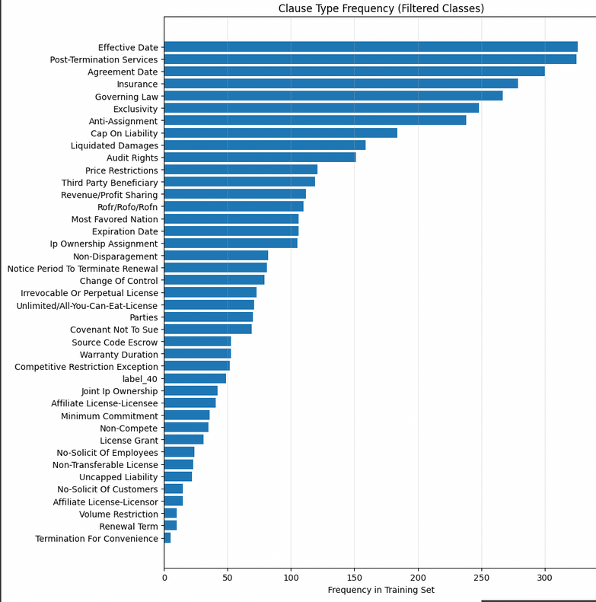
Dataset Overview
Source: Contract Understanding Atticus Dataset (CUAD)
Size: 510 commercial legal contracts, 13K+ labeled clauses
Categories: 41 key clause types (e.g., Non-Compete, Governing Law, NDA, Termination)
Labels: Factual answers (dates, entity names) and Yes/No flags
Grouping: Some categories combined to reflect legal dependencies
Relevance: Supports automated contract checking and risk detection
CUAD dataset with 41 clause types of varying frequency

Slide 6

METHODOLOGY
1
2
3
4
5
CUAD dataset containing over 13,000 labeled clauses from 510+ commercial legal contracts across 41 clause types.
Trained baseline models and fine-tuned transformers (BERT, RoBERTa, LegalBERT).
Cleaned and normalized text, removed noise, tokenized, and prepared multi-label binary targets.
Feature Representation Extracted TF-IDF generated tokenized inputs.
Assessed and compared models performance

Slide 7
Preprocessing
The dataset was split by contract ID into training, validation, and test sets to avoid leakage.
For baselines the text was lowercased, cleaned of punctuation, digits, and URLs, tokenized, stopwords removed, and lemmatized.
The labels were converted into a binary matrix for multi-label classification.
For transformers, we used the Hugging Face tokenizer with truncation and padding to 512 tokens.
Input IDs and attention masks were created, and labels were stored as float arrays.
Class imbalance was addressed using positive weights and focal loss experiments.

Slide 8
TF-IDF and Transformer Input Representation
For baselines, we extracted features using TF-IDF with unigrams and bigrams.
Vocabulary size was limited using min_df, max_df, and max_features.
This produced a sparse document–term matrix aligned with the multi-label binary matrix.
For transformers, tokenized inputs (input_ids and attention_mask) were used directly.
The transformer learned dense contextual embeddings during fine-tuning.

Slide 9
Model
Baseline Models
Transformers
Used TF-IDF features with unigrams and bigrams as input.
Applied a One-vs-Rest strategy for multi-label classification.
Model 1: Logistic Regression with regularization tuned on the validation set.
Model 2: Random Forest with parameters such as number of trees and depth tuned for best performance.
Labels represented as a binary matrix using MultiLabelBinarizer.
Evaluated on Micro-F1, Precision, and Recall metrics.
Fine-tuned BERT (bert-base-uncased), RoBERTa (roberta-base), LegalBERT (nlpaueb/legal-bert-base-uncased) for legal domain adaptation.
All models used a 41-label classification head.
Tokenized with Hugging Face AutoTokenizer, truncated/padded to 512 tokens.
Optimized with AdamW, warmup scheduling, and gradient clipping and early stopping.
Applied focal loss or BCEWithLogitsLoss to handle class imbalance.

Slide 10
Demo

Slide 11

Results
Baseline models used TF-IDF features with Logistic Regression and Random Forest.
Transformers included BERT, RoBERTa, and LegalBERT fine-tuned for clause classification.
Transformers outperformed baselines in capturing complex legal language.
LegalBERT and RoBERTa handled rare clause types more effectively than BERT and baselines.
Baselines were faster to train but had lower recall for nuanced clauses.
Overall, transformers achieved the best balance of precision and recall.

Slide 12
INFERENCE
LegalBERT:
Maintains a strong balance between precision and recall.
Effective for accurate clause identification without excessive false positives.
RoBERTa:
Achieves the highest recall among all models .
Ideal when missing a relevant clause has a high cost .
BERT:
Useful for exploratory review where capturing all possible clauses is more important.
Logistic Regression:
Outperforms Random Forest among baselines and generalizes more consistently.
Random Forest:
Less accurate than Logistic Regression in this task.

Slide 13
Conclusion
Automated clause classification can significantly speed up contract review.
Baseline models with TF-IDF provide strong starting points.
Transformer models, especially LegalBERT, handle complex legal language better.
Class imbalance remains a key challenge for rare clause types.
Proper preprocessing and threshold tuning improve overall performance.
In future, we can focus on data augmentation and larger language models.

Slide 14
Thank You

